Slide 1
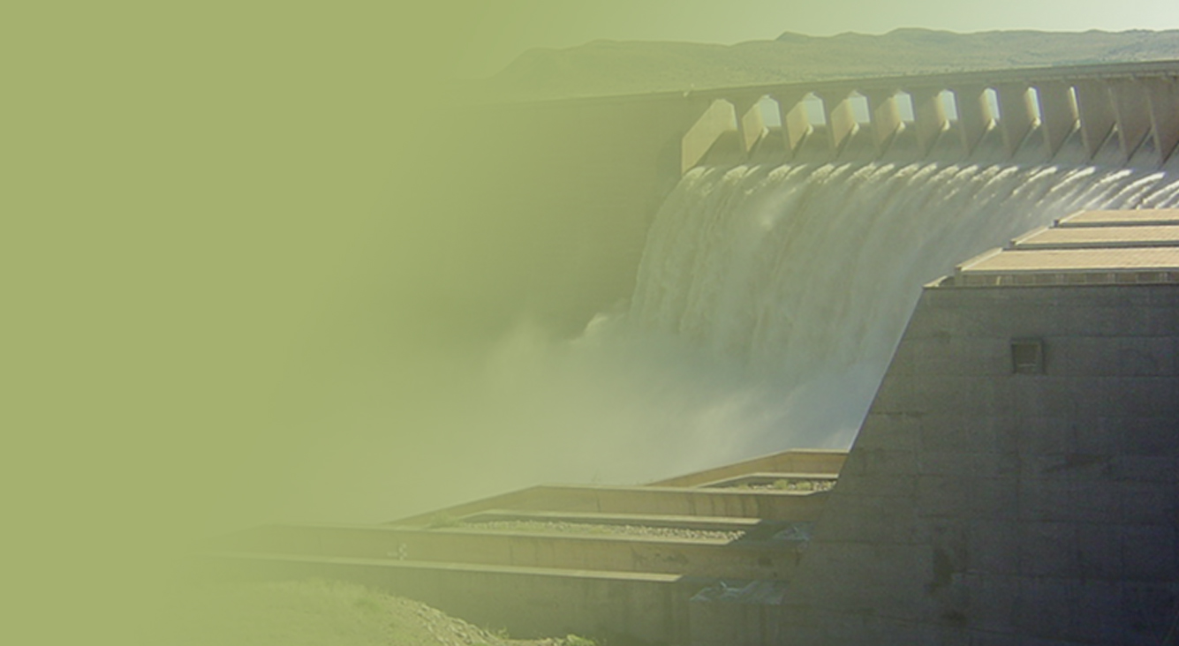
The Determination of Water Resource Classes and Resource Quality Objectives (RQOs) in the Breede-Gouritz WMA
Presented by: E Lekalake
Department: Water & Sanitation
Date: 12 June 2018

Slide 2
Purpose of the meeting
To provide feedback on the progress of classifying and determining the Resource Quality Objectives for the water resources in the Breede-Gouritz WMA
To provide the necessary information to engage with stakeholders on proposed RQOs for determined water resource classes in the Breede-Gouritz WMA
To provide an overview of next steps in the study

Slide 3
Classification and determination of RQOs
The classification and determination of the RQOs study in the Breede-Gouritz WMA was initiated in May 2016
Timeframe: 24 months
Aurecon South Africa (Pty) Ltd was appointed to assist DWS.
The objective of the study is to classify and determine RQOs in the Breede-Gouritz WMA

Slide 4
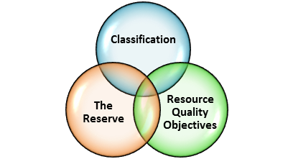
Legal Mandate
Chapter 3 of the National Water Act, (No. 36 of 1998) deals with the protection of water resources
The measures for protection of water resources are:
Classification (S13)
Reserve (S16)
Resource Quality Objectives (S13)
S12 requires the Minister to establish the Water Resource Classification System, (WRCS)
WRCS was published as Regulation 810 in Government Gazette No. 33541 dated 17 September 2010
The WRCS defines:
water resource classes and
the procedure to determine Class, RQOs and Reserve
According to the NWA, once the WRCS has been gazetted all significant water resources must be classified and Resource Quality Objectives determined.

Slide 5
Study Process & Progress
1
2
3
4
5
6
7
Assessment of WMA
Divided into catchment areas (IUAs) based on socio-economic/
land use characteristics/
water resources (IUAs)
Data assessed
Status quo understood
Value and condition of water resources
Goods and services assessed
Economic Framework for decision making developed
Ecological requirements of water resources understood and quantified
How much water does the ecology require for different protection levels
Models set up with ecological requirements and water requirements
Set and test a sustainable ecological protection level scenario for water resources
Set other scenarios (future states) and evaluate within the integrated water resource management context of WMA
Understand the implications of different protection levels
Evaluate the scenarios with the stakeholders
Stakeholders evaluate scenarios and agreed on shortlist
Recommended classes for the IUAs
Gazetting
Gazette the class configurations
We are here
COMPLETED
Stakeholder engagement

Slide 6
Study Process & Progress
RQOs 7-Step Procedure
: completed
: in progress
: next steps
1. Delineate the IUAs and RUs
2. Establish the vision for the catchment
3.
Prioritise & select RUs
4. Prioritise sub-components, select indicators & propose direction of change
5. Develop draft RQOs & numerical limits
6. Agree RUs, RQOs & numerical limits with stakeholders
Monitoring & Compliance
7. Finalise & Gazette

Slide 7
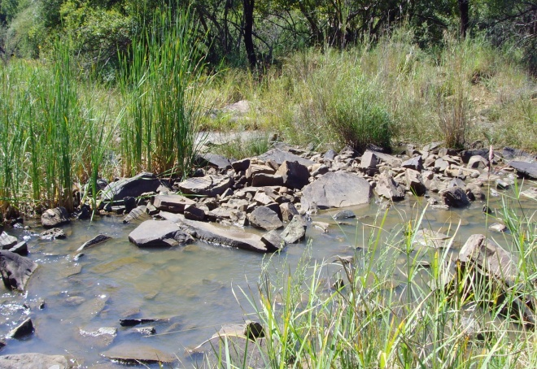
Resource Quality Objectives (RQOs):
In essence:
RQOs are the objectives or goals which can be measured or monitored to determine whether the Water Resource Class is being achieved.
7

Slide 8
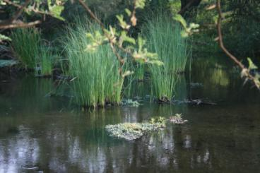
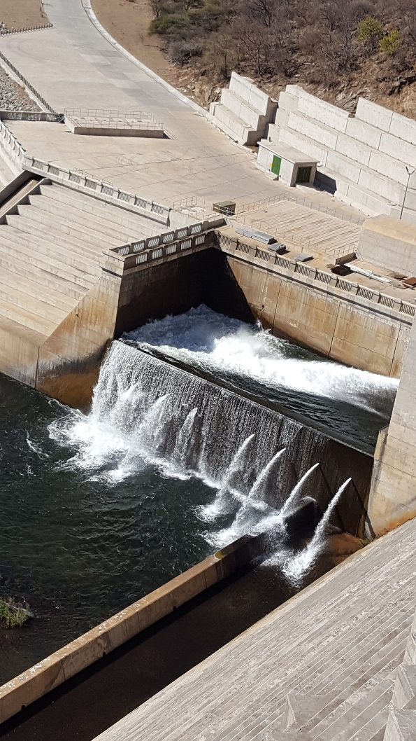
Resource Quality Objectives (RQOs):
RQOs can be numerical and/or descriptive statements and may relate to:
what the quantity of the water should be (water level, pattern, timing)
what the water quality should be (physical, chemical and biological
what the condition of the instream and riparian (river bank) habitat should be
what the condition of the aquatic (water) animal and plant life should be.
8

Slide 9
Determined for surface water and groundwater resources:
Rivers
Dams
Wetlands
Estuaries
Groundwater

Slide 10
Resource Units
163 resource units were prioritised for the setting of RQOs (Breede-Overberg)
112 Rivers
5 Estuaries
6 Dams
13 Wetland
27 Ground water

Slide 11
Resource Units
181 resource units were prioritised for the setting of RQOs (Gouritz-Coastal)
144 Rivers
12 Estuaries
2 Dams
9 Wetland
14 Ground water

Slide 12
FOR WHICH COMPONENTS AND INDICATORS ARE RQOs SET?

Slide 13
COMPONENTS AND SUB COMPONENTS
(RIVERS, DAMS, WETLANDS, ESTUARY)
WATER QUANTITY
High Flows
WATER QUALITY
Nutrients
HABITAT
Instream Habitat
Riparian Habitat
BIOTA
Low Flows
Salts
System Variables
Toxics
Pathogens
Aquatic and Riparian plant species
Mammals
Birds
Periphyton
Aquatic Invertebrates
Fish
Diatoms

Slide 14
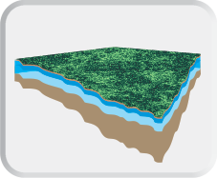
COMPONENTS AND SUB COMPONENTS
(GROUNDWATER)
Measurable parameters including:
Quantity (Abstraction),
Aquifer Water Level,
Water Quality, and
Protection Zones (related to a localised borehole as a means of protecting the basic human needs and the ecological Reserve).

Slide 15
Stakeholder Engagement
Public Consultation meeting - 15 -16 November 2016
1st Project Steering Committee meeting - 14 February 2017
2nd Project Steering Committee meeting - 29 November 2017
1st Technical Task Group meeting – 24 April 2017
2nd Technical Task Group meeting – 12 -16 March 2018
Estuary sector meeting – 19 April 2018
Agriculture sector meeting – 24 May 2018
Municipality sector meeting – 13 June 2018
Public meetings – 23 -24 July 2018
All issues and responses are being captured in a register (ongoing)

Slide 16
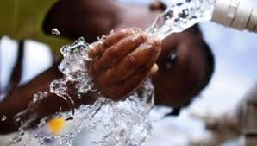
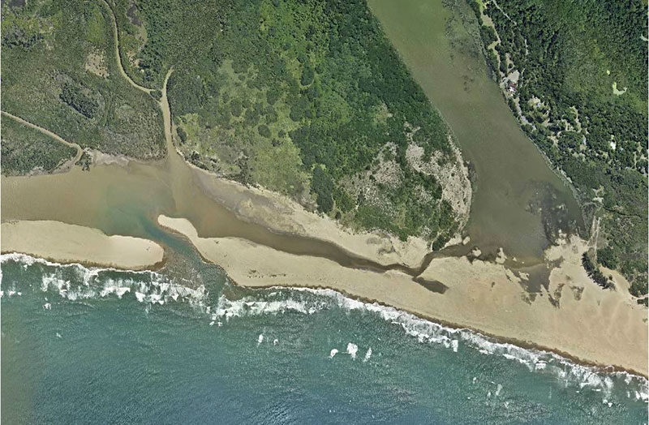
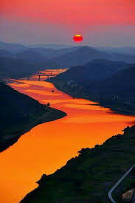
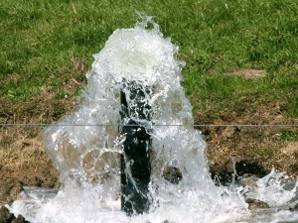
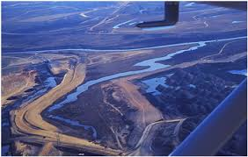
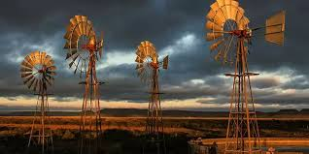
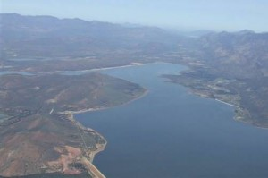
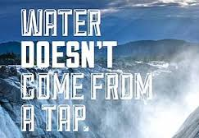
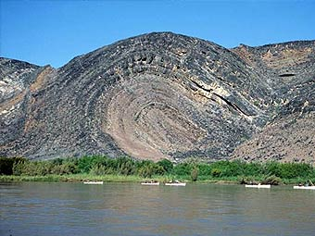
THANK YOU!
Estuaries
Rivers
Groundwater
Wetlands
Dams

Slide 17
Way forward
Gazetting process has started
Municipality sector meeting – 13 June 2018
Public meetings – 23 -24 July 2018
All issues and responses are being captured in a register (ongoing)

